Slide 1

Workshop on Dynamics of Creative Improvisation
Characterization of Affect in Audio from Non-Linear VMO Dynamics
Pauline Mouawad, Shlomo Dubnov.

Slide 2
Chaos Theory and Dynamic Systems
Chaos theory: studies the behavior of dynamical systems, i.e. systems that are highly sensitive to initial conditions – a response popularly referred to as the 'Butterfly Effect'.
  Small differences in initial conditions yield widely diverging outcomes for such dynamical systems, rendering long-term prediction impossible in general.
Examples of dynamic systems:
  Pendulum
  Vibrating strings in musical instruments
  Vibrating vocal folds in voice

Slide 3
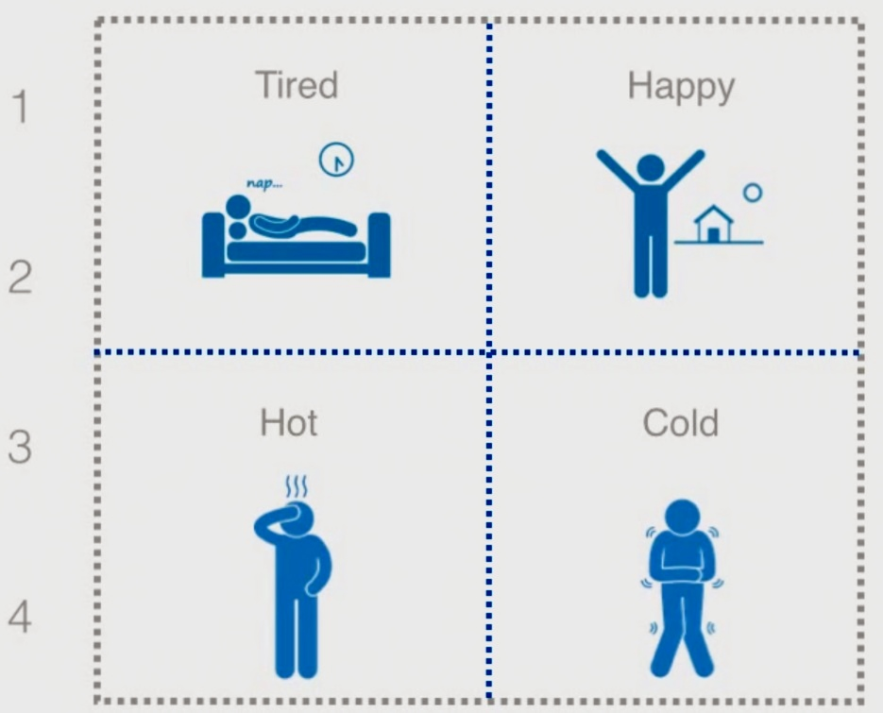
Nonlinear signal analysis and time series
“The most direct link between chaos theory and the real world is the analysis of time series data in terms of nonlinear dynamics”
Nonlinear signal analysis characterizes the signal's underlying dynamics based on the study of phase space trajectories that capture all possible changes of a system's state over time, where each possible state corresponds to one unique point in the plot.
Attractor: subset of the phase space that
corresponds to the set of states towards
which the system tends to evolve.
Time-series: When system dynamics are
unknown, one or more sequences of
observations are taken as a function
of time to create time-delay embedding
that reconstructs the phase space of the
dynamical system.
Recurrence plots: plots that offer a view in terms of pairs of times, the times at which phase space trajectory returns to a location visited before. The entry R_{ij} is set to 1
and is represented by a black pixel in the plot, if two states at different times are similar, i.e., the points x(t_{i}) and x(t_{j}) in phase space fall inside a ball of radius ε, the threshold distance.
Phase space

Slide 4
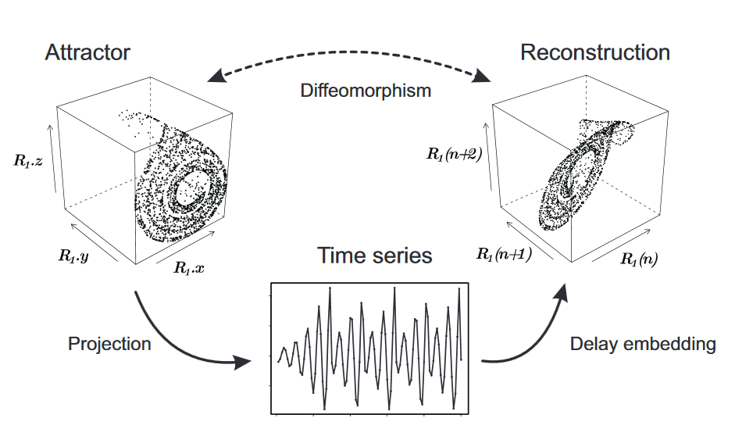
Nonlinear Dynamics Analysis Workflow

Slide 5
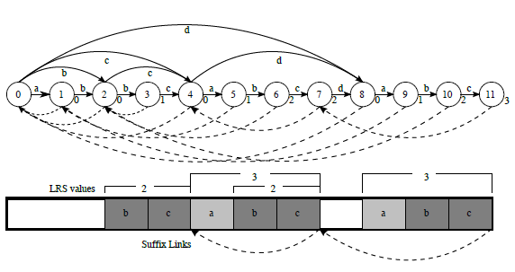
RP from Variable Markov Oracle (VMO)
Symbolization: Coarse-grain the phase space and associate original observations with symbolic values.
Then the sequencing process allows the identification of temporal patterns in the symbol sequences as well as deriving global characterization of such sequences in terms of entropy and recurrence statistics.
No need for phase space embedding.
VMO captures approximately repeating suffixes in time series and detects recurrences of sub-sequences of variable length.
The VMO-RP is constructed from the repetitions found by the VMO method.
VMO Recurrence statistics (VMO-RQA) are derived.

Slide 6

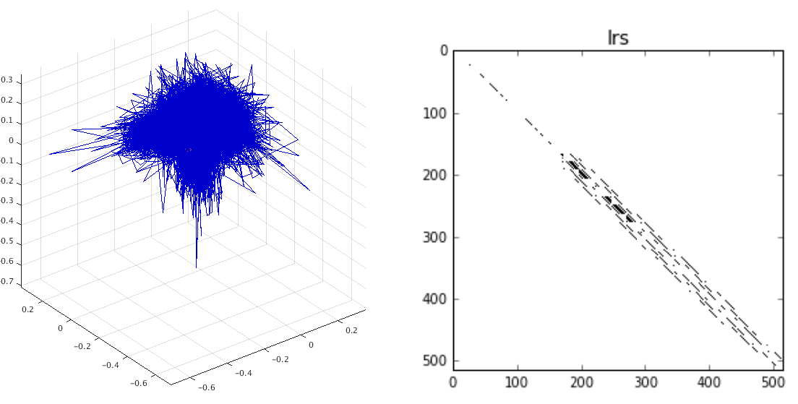
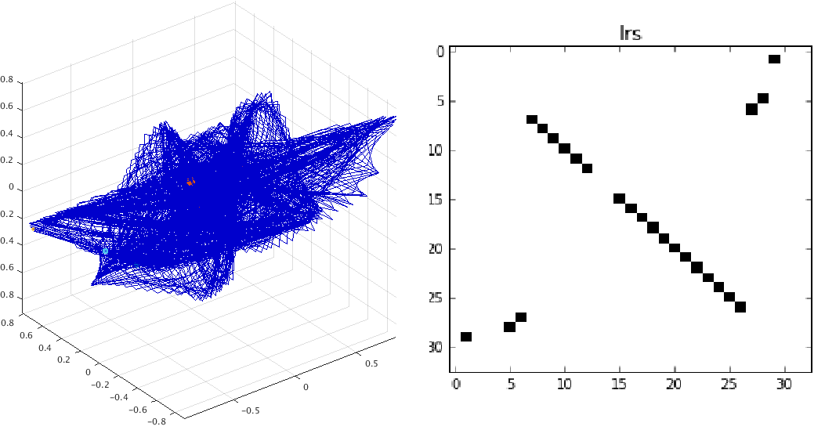
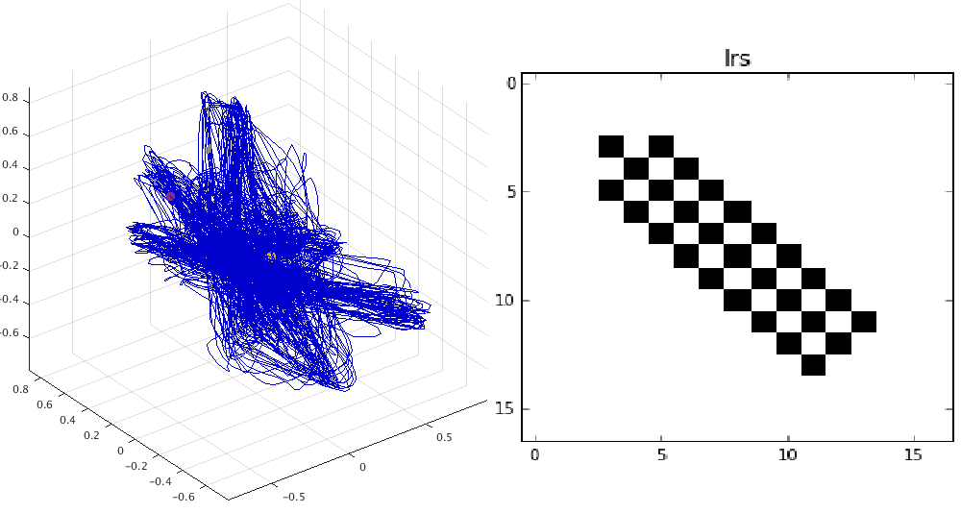
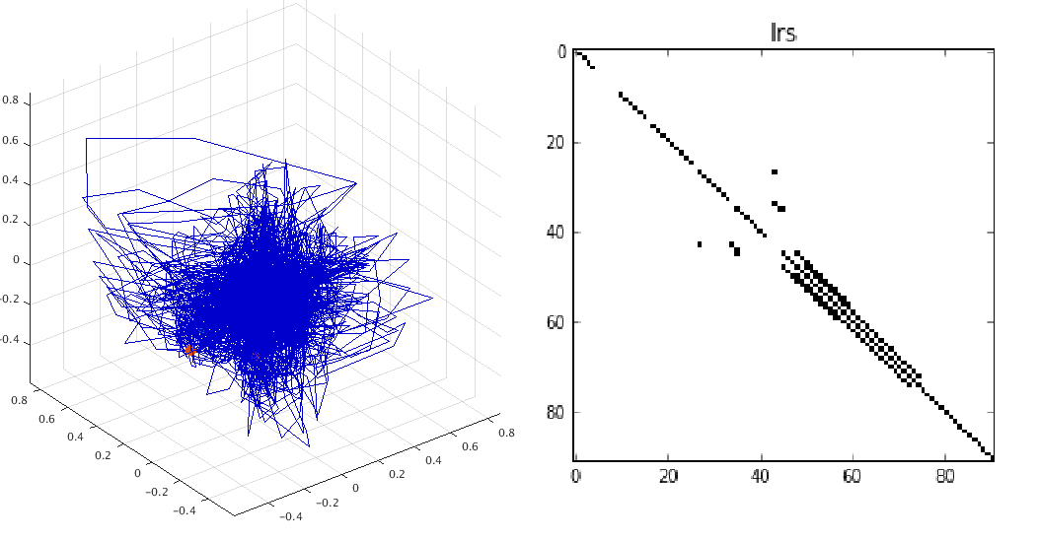
Phase spaces and VMO-RP
Lawn Mower
Pain
Laughter
Neutral
`

Slide 7
RP Quantification or Recurrence Quantification Analysis (RQA)
RQA is the quantification of structures in recurrence plots, it investigates recurrence-related properties of complex dynamical systems, and can be applied to various types of data, including non-stationary processes.
Example: the RQA metric Determinism can discriminate signals from noise.
Given an RP:

Slide 8
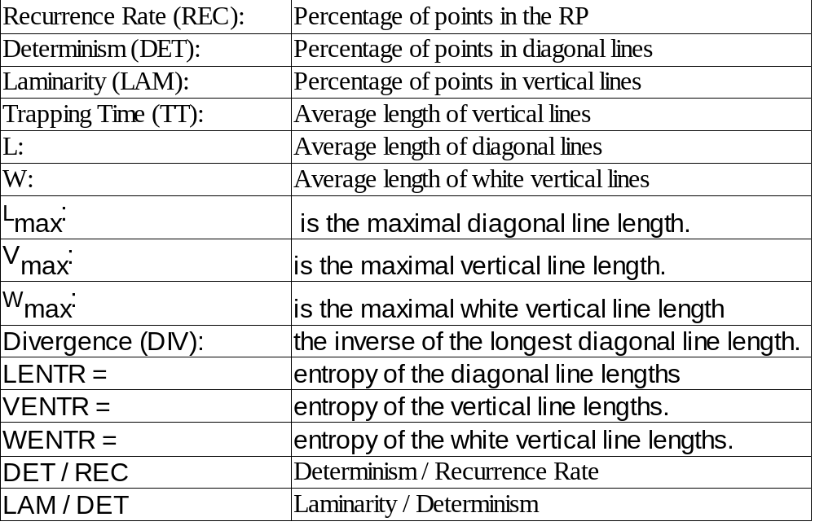
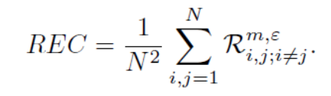
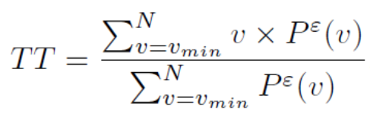

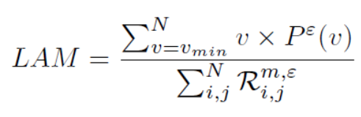
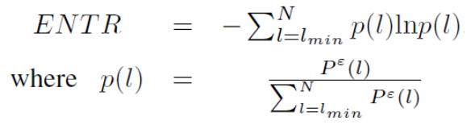
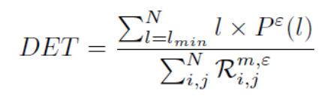
VMO-RQA

Slide 9
Results: Classification Performance Measures
1) For Auditory Scenes:
2) For Affective Vocalizations:

